Slide 1
Customer Churn Analysis.
Date: 9/15/2025
For: Customer analysis
By:
Audrey

Slide 2
Overview.
This details the development of a predictive model aimed at identifying customers at high risk of churning from a telecommunications company.
By building a reliable system to forecast churn, this project provides a proactive tool to the customer retention team, enabling them to intervene and reduce the overall churn rate.

Slide 3
Business understanding .
Customer churn is a significant challenge for any subscription-based business. The traditional approach is reactive, often addressing a customer's issue only after they have decided to leave.
Our solution shifts this to a proactive strategy, using data to identify customers with a high probability of churning before they leave.
The goal is to maximize customer lifetime value and improve retention.

Slide 4
Data Understanding .
The dataset is a historical record of customer information, including usage metrics, account details, and a churn flag. The analysis of this data revealed that customer behavior is a key driver of churn. The strongest indicators were:
High customer service calls: A clear sign of frustration.
Presence of an international plan: A key indicator of customers with more options.
Lack of Voice mail plan: The presence of this feature appears to be a factor in customer loyalty.

Slide 5
Data Analysis Report

Slide 6
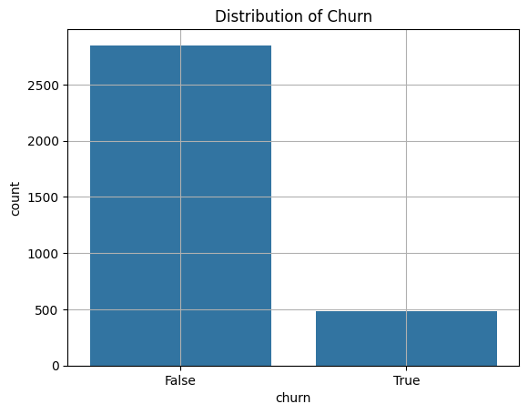
Churn distributions
This shows most customers did not churn, while only a small proportion did

Slide 7
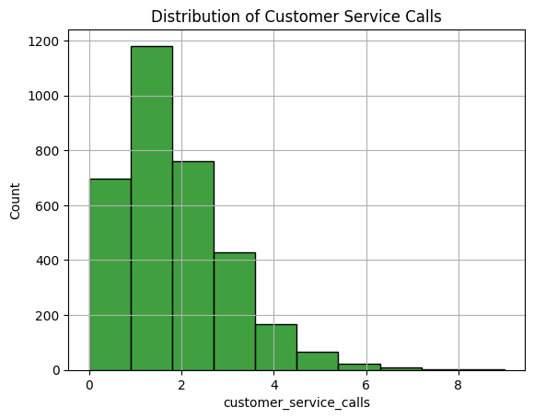
Distribution of customer service Calls.
The histogram shows that most customers made between 0 and 3 service calls, with the number decreasing as calls increase. A smaller group made 4 or more calls, which may indicate dissatisfaction and a higher likelihood of churn.

Slide 8
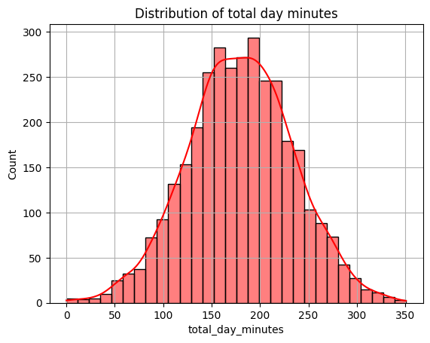
Distribution of total day minutes.
The histogram shows a roughly normal distribution, with most customers clustered around the mid-range and fewer at the extremes. A few customers have very high usage, appearing as outliers. This suggests that while most customers use a moderate amount of daytime minutes, heavy users exist and could influence churn behavior.

Slide 9
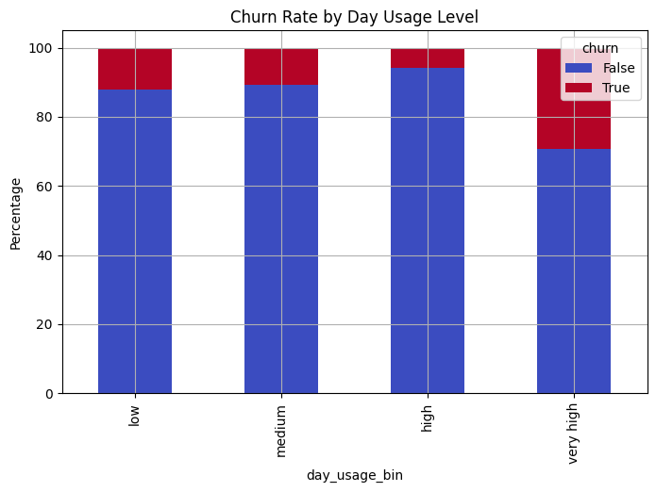
Distribution of churn vs day usage bin.
The analysis shows that customers in the low usage group have the lowest churn rate, while those in the high and very high usage groups are more likely to churn. This suggests that heavy daytime users, who generate higher charges, are more dissatisfied and prone to leaving, whereas light users remain more stable.

Slide 10
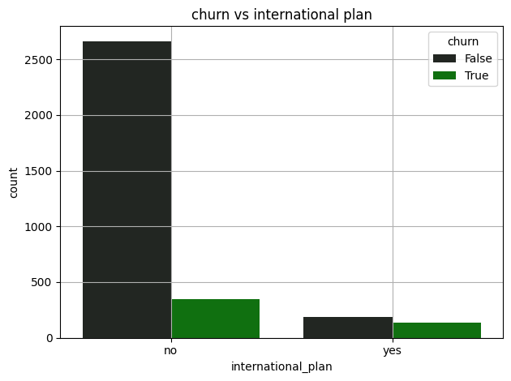
Distribution of International vs churn.
The plot shows that customers with an international plan are more likely to churn compared to those without the plan. Most non-international plan users tend to stay, suggesting that having an international plan may be linked to higher churn risk.

Slide 11
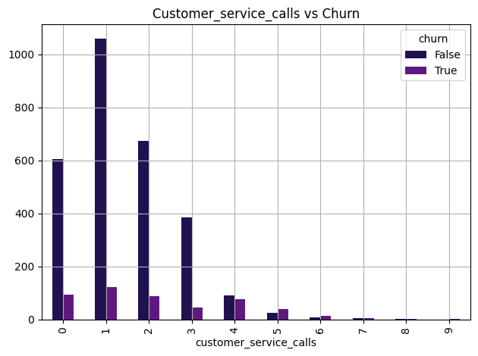
Distribution of customer service calls vs churn.
The distribution shows that as the number of customer service calls increases, the likelihood of churn also rises. Customers with more service calls are more likely to leave, indicating that frequent complaints may lead to churn.

Slide 12
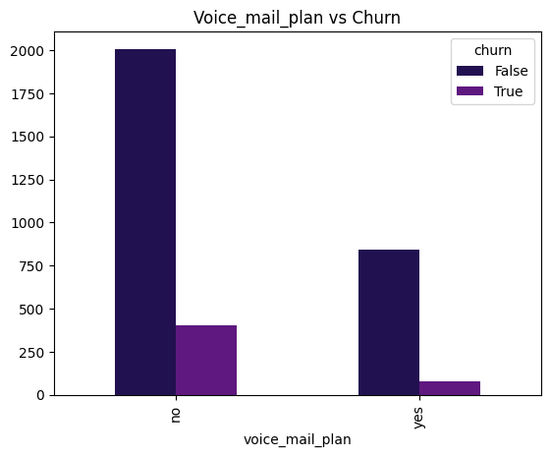
Distribution of voice mail plan vs churn.
Customers with a voice mail plan tend to churn less compared to those without one. Most customers without a voice mail plan stay.

Slide 13
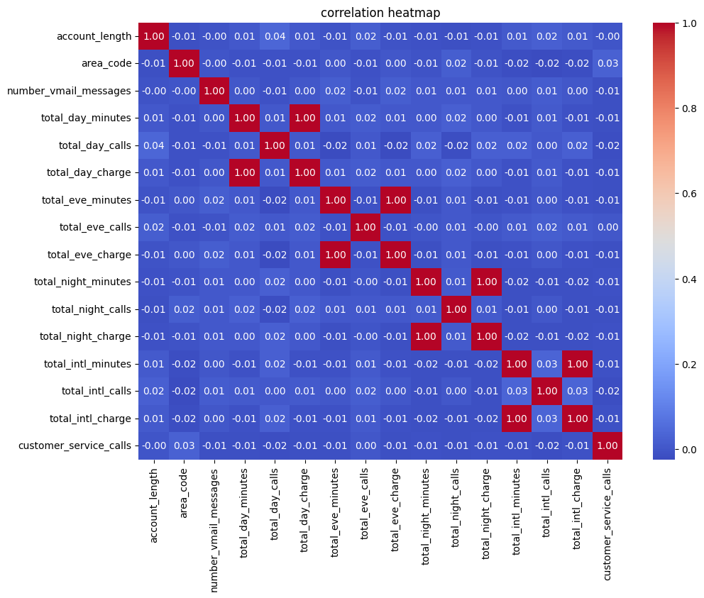
Correlation Heatmap.
The correlation matrix shows that the perfect positive correlation (r=1.00) between minutes and charges for all times of day, which is expected since the charge is based on usage. All other variables, like account length and area code, have no significant linear correlation with one another

Slide 14
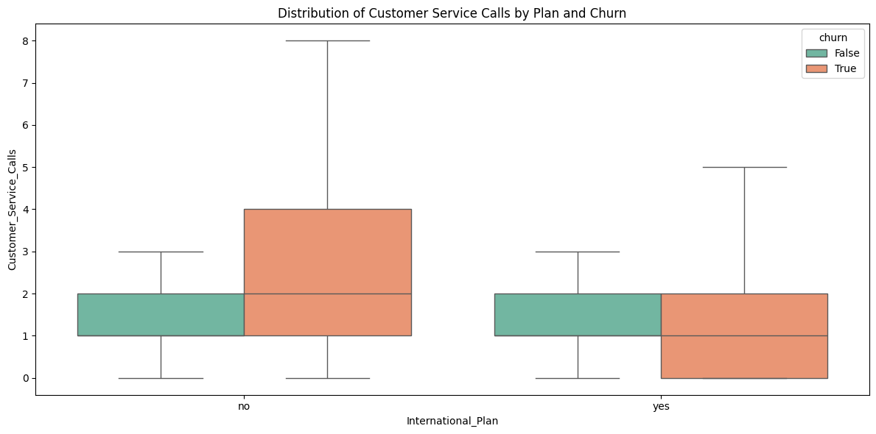
Distribution customer service calls
Customers with an international plan who also have high day-time usage are most likely to churn. While customers who churn generally use more total day minutes than those who don't, the effect is magnified for those with an international plan. This suggests that the combination of both factors creates a powerful indicator of churn, likely due to high costs or frustration with service on the international plan.

Slide 15
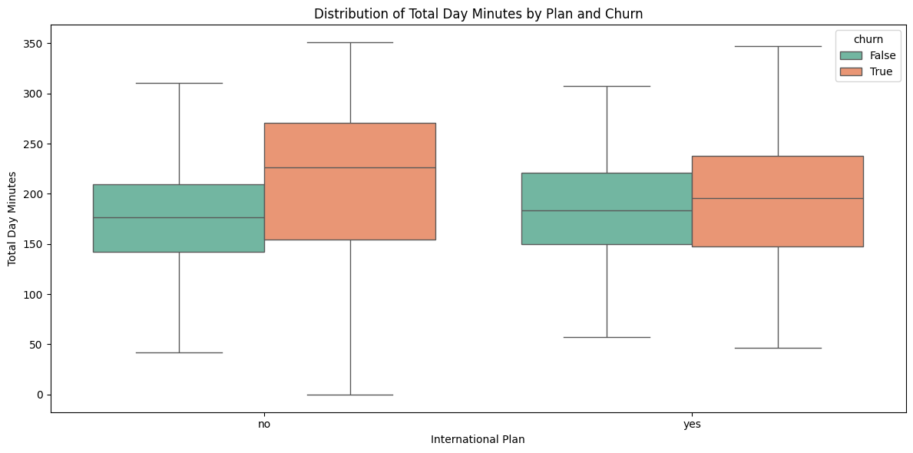
Group Comparison on Call behaviour
Customers who churn have a higher average total day minutes and this trend is especially strong among those who have an international plan.

Slide 16
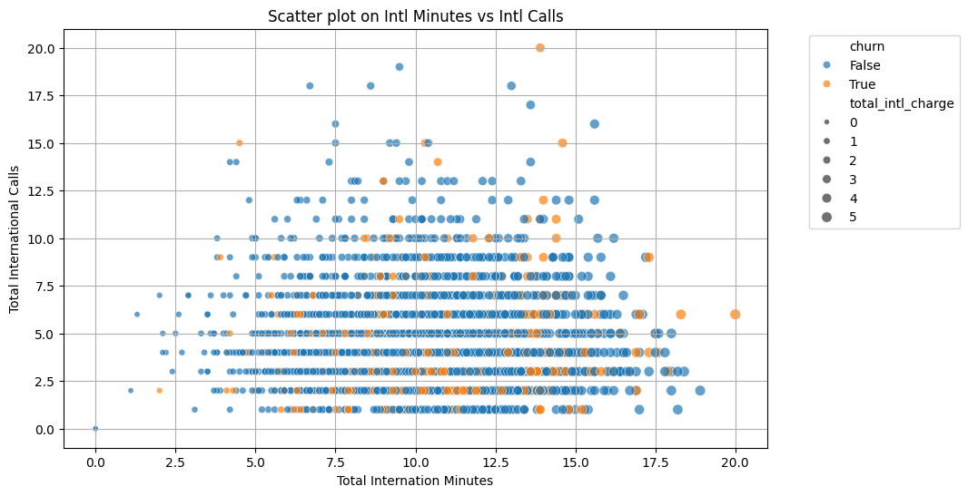
Scatter Plot on international minutes vs international calls
This plot visually confirms that while international usage is correlated with churn, it's not the total amount that matters most, but the fact that a customer has an international plan in the first place.

Slide 17
Statistical and Hypothesis Testing
To do this, will perform two key tests:
T-tests- for the numerical features to see if there is a significant difference in the average values between churned and non-churned customers.
Chi-Squared tests- for the categorical features to determine if there is a statistically significant relationship between a customer's plan type and their churn status.

Slide 18
Modeling
.
Data preprocessing.
Data preprocessing was a critical step to ensure the models could learn effectively. Key steps included:
Categorical Encoding: Converting non-numerical data into a machine-readable numerical format.
Feature scaling: Standardizing numerical features to prevent any single feature from disproportionately influencing the model.
Data Balancing: I applied SMOTE (Synthetic Minority Over-sampling Technique) to address the data imbalance, which is a common issue in churn prediction. This created a more balanced dataset, allowing the model to more accurately learn to predict the minority class (churned customers).

Slide 19
Model Selection.
.
After evaluating several algorithms, the Random Forest Classifier was selected as the final model. It was chosen for its high performance and ability to handle the complex, non-linear relationships within the dataset. The model's feature importance chart confirms that it prioritized the same key features identified in our initial analysis:
Num total call minutes and num customer service calls columns were identified as the most important features for predicting churn, reinforcing early findings.

Slide 20
Evaluation.
.
The model was evaluated using a variety of metrics, with a primary focus on Recall for the churn class. This metric is crucial because it measures the model's ability to correctly identify all customers who will churn.
Recall Score: The model achieved a 71% recall, meaning it can successfully identify over two-thirds of all customers who are going to churn.
ROC-AUC Score: The model's ROC-AUC score was 0.85, which demonstrates its strong ability to distinguish between churned and non-churned customers.

Slide 21
Conclusion.
.
The project successfully built a predictive model to identify customers at risk of churning, shifting from a reactive to a proactive strategy.
The Random Forest model proved highly effective, confirming key insights from the initial data analysis
The model provides actionable recommendations for improving customer retention, focusing on high-risk customers, key behavioral drivers and promoting features.
Ultimately , this project delivers a reliable system that empowers the business to enhance customer satisfaction and increase retention.

Slide 22
Recommendations.
.
Based on the model's findings , the following are the recommendations to the customer retention team:
Prioritize High-Risk Customers: Use the model's output to create a daily list of customers with the highest churn probability. These customers should be proactively contacted with offers or support.
Target Campaigns: Launch specific campaigns focused on customers with an international plan or a high volume of service calls, as our analysis shows these are key indicators of dissatisfaction.
Promote Features: Market features like voice mail plan, which the findings show a strong correlated with customer loyalty and retention.
Continuous Monitoring: Implement a process to regularly update and retrain the model with new data to ensure its predictive accuracy remains high over time.

Slide 23
Questions?

Slide 24
Thank you! Click here https://github.com/audreychela/dsft_phase_3_project to view the full project. Feel free to leave comments and insights.

